Slide 1

Riley, Abdalla, Elvir

Slide 2
Table Of Contents
Introduction
Vision and Scope
Business Value
Feasibility Studies
Software Development Methodology
Proposed System Functionalities
Initial use case diagram of your system
Hardware & Software Requirements
Project log and Project Plan
GitHub location: https://github.com/ld1397zm/ICS499

Slide 3
Introduction
There is a need for a simple to use application that can manage a hotel’s cleaning schedules.
Tracking and Managing a hotel’s cleaning schedules on paper is inefficient and prone to errors
Our application aims to fill the need for a simple to use hotel management system that will make it far easier to move away from paper tracking.

Slide 4
Vision
To provide an easy to use application that can help hotels manage their cleaning schedules. Our application will help eliminate the use of paper to track the cleaning schedules and allow the office management the ability to update that information seamlessly.

Slide 5
Scope
A three-tier web application that will allow Management to create and modify cleaning schedules for a hotel. The employees check the schedules to see their assignments. Management may use an autoscheduling component to automatically generate work schedules.

Slide 6
Business Case
In the hospitality industry, significant man-hours are spent inefficiently in the related tasks of booking and room-keeping. Rather than requiring an employee for the task of recording the status of rooms and their associated ledgers, an alternative is being sought in using computers to do the same.
This software will reduce operational costs in two ways - housekeeping will receive reports on which rooms need to be serviced, rather than visiting every room in a route. This will reduce the amount of labor required to maintain the rooms. Secondly, this software will use a database to record information and produce reports, reducing the chance for employee user error as well as the amount of time required to process booking and payment status.
RS

Slide 7
Feasibility Study
This program will be designed using the Agile framework, and will incorporate client input at each iteration of the project.
This project will use established languages and methods to create a 3-tier application with a user frontend, a software backend, and a data store in the form of a MariaDB database, through the XAMPP platform.
The code lifecycle will last for several iterations each roughly two weeks long, allowing for gradual and incremental specification and development.
RS

Slide 8
Software Development Methodology
Hotel Management Software will be using the Agile Software Methodology. After receiving the main requirements from the customer, we will be able to meet with them periodically and have them test the system as well make any corrections before the final implantation.

Slide 9
Hardware & Software Requirements
This software will run on x86 and x86_64 personal computers, for ease of deployment in hotels and motels. This software will run on both Linux and Windows platforms.
This software will be constructed from several platform-agnostic scripting languages, including PHP, JavaScript, CSS and HTML. We will also be using the interpreted language Python. Also, this software will be backed by a local database powered by MariaDB, through the XAMPP platform, for the purposes of persistent and historical logging.
RS

Slide 10
Proposed System Functionalities
The functionality of the application is to provide the hospitality service in fully editing options such as deleting, adding, or creating a cleaning schedule. The master user would be the manager of the hospitality service and have the capability of editing the schedule.
The end-user would be employee, with an option to view, search and export the cleaning schedule. Employees will also have the option to view “Do not disturb”, “Occupied”, or “Unoccupied” rooms. It will also provide a current status of the room if it is cleaned or uncleaned.

Slide 11
Use Case: Identifying the Actors
Management | Login Logout Create Schedules View Schedules Create New User accounts Delete User Accounts
Employees | Login Logout View Schedules Sort Schedules Export Schedules Search Schedules

Slide 12
USE CASE
-Managers will produce schedules for their employees. They will be able to create, delete and modify schedules. They will be assigning employees to specific rooms based on the availability of the room and the availability of the employee. Management will be will have the power to manage accounts. They will be able to create, modify, and delete accounts.
-Employees will be assigned rooms depending on their workshifts. Employees will be able to login and logout of their account. Employees will be allowed to sort the schedule by name and and export their schedules into pdf format. Management will be able to create schedules for the hotel management systems.

Slide 13
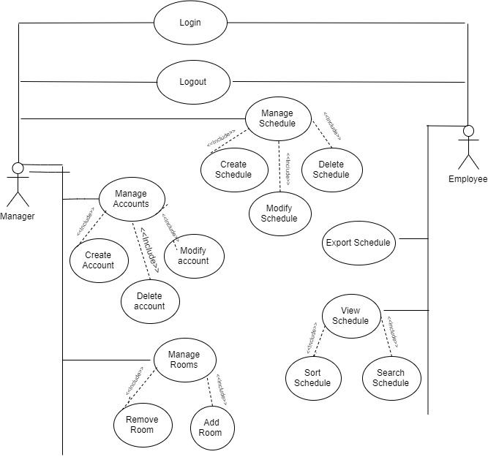
USE CASE DIAGRAM
RS

Slide 14
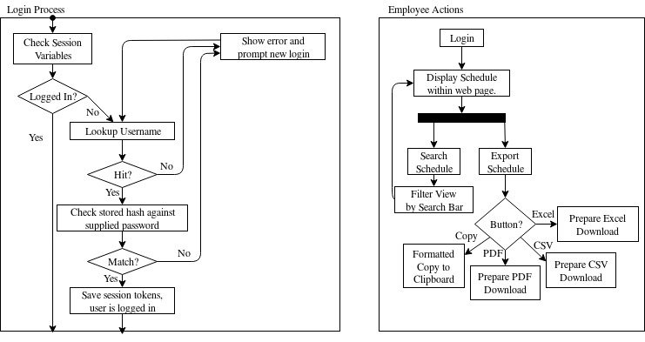
Employee Activity Diagram
RS

Slide 15
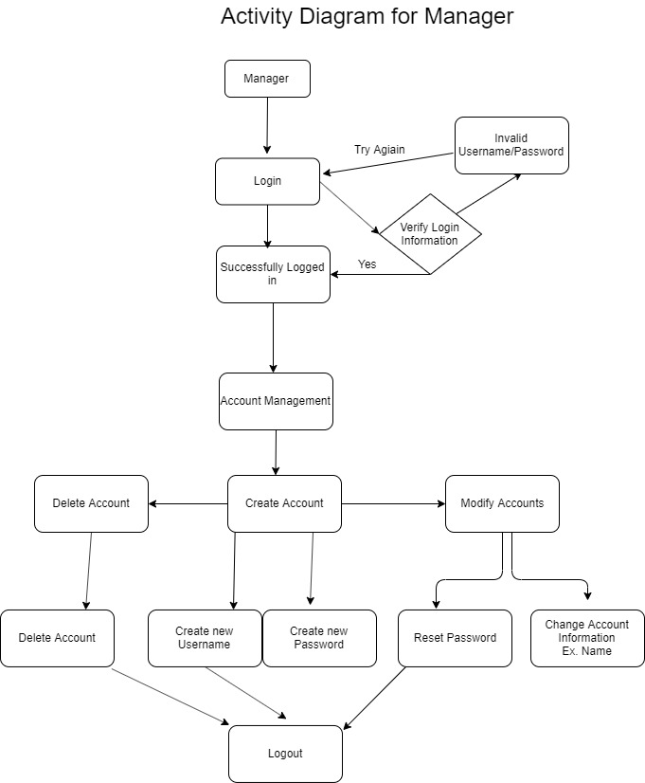
Manager Activity Diagram

Slide 16
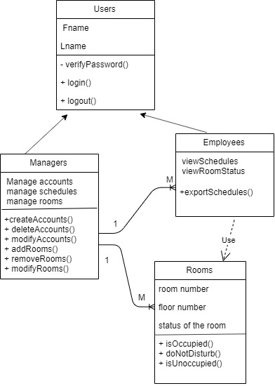
Class Diagram

Slide 17
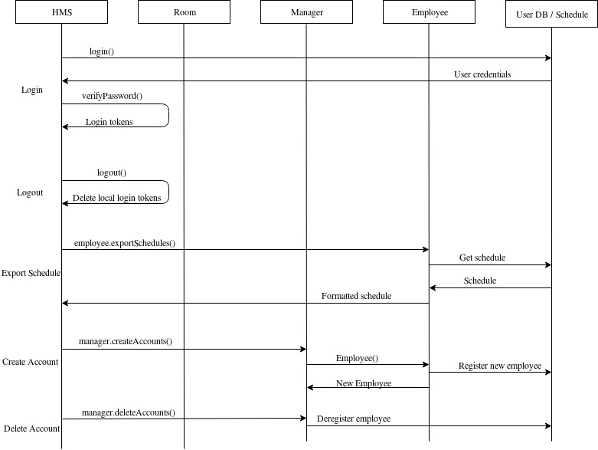
Sequence Diagram

Slide 18
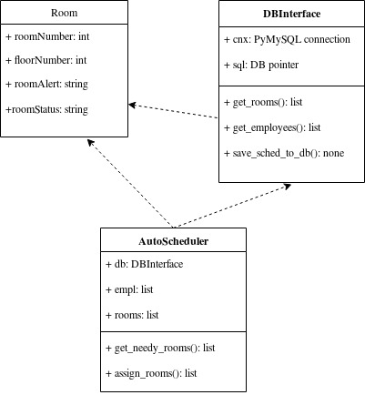
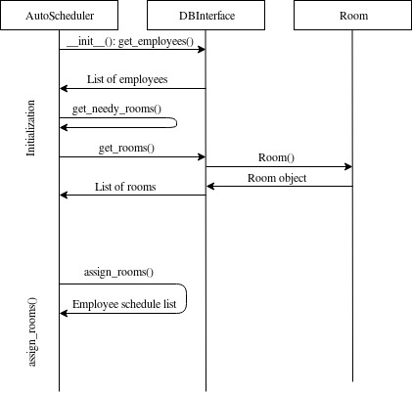
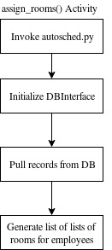
Diagrams for Python component
RS

Slide 19
Project Log
8/27/19 | We met each other and got to know our group members. We started thinking about project ideas. We created a slack group. | 10/01/19 | The group met in-class. Abdalla worked on the activity diagram, Riley updated the use-case diagram and submitted a link to GitHub to D2L. Elvir worked on the site prototype.
9/03/19 | We made our pick in the project to work. We divided up the work for the iteration 1 presentation. We also created a github and a google doc to keep track of each person’s assignments. We started to create the PowerPoint presentation. | 10/08/19 | Riley absent. Abdalla and Elvir presented the project for Iteration 2.
9/10/19 | The group checked on the progress of each member. We expanded some of the functionalities of the project. We made some changes to the use case diagram. | 10/15/19 | Reviewed current status of prototype. Abdalla worked on class & use-case diagramming.

Slide 20
Project Log, Continued
10/22/19 | Abdalla absent. Elvir, Riley worked on the user database & the login process. | 11/4/19 | While in admin mode (manager) have the export options for; copy, Excel, CSV, PDF for the schedule.
10/29/19 | Elvir absent. Riley worked on updating activity, sequence diagrams. Riley worked on employee auto-scheduler. | 11/5/19 | Riley finished diagrams, initial script for AutoScheduler. Save-to-DB still not working. Updates to presentation. Presented in class.
11/3/19 | Elvir create a admin login with edit option to edit the schedule. Create a registration log for customers (employees) have each registration add to db. Have the db check if its admin or employee.

Slide 21
Plans for Iteration
Complete the Project
Finish the front end
Split up the work on the Project Report and finish it

